Slide 1
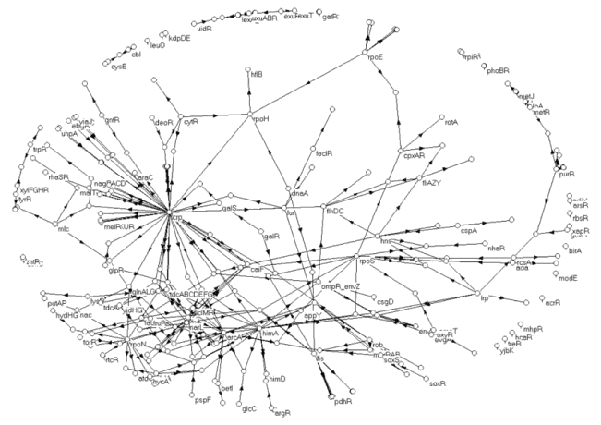
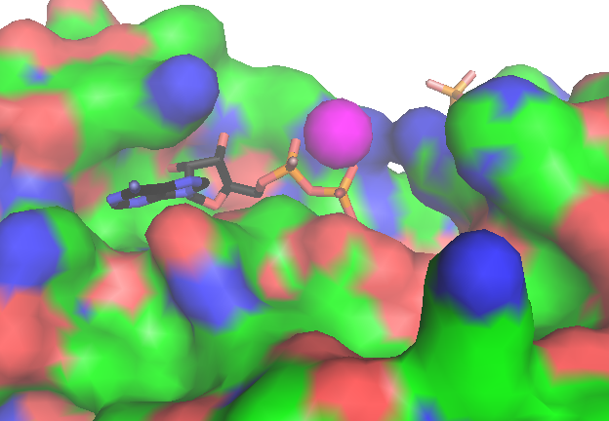
MCB 135 Lecture 4 Constraints imposed by the parts in biological systems
Notes:
Walter Pitts, John von Neumann

Slide 2
A few logistical issues
First two lecture recordings from week one now available
Paper discussion time to be set Wednesday
First meeting next week
Problem set 1 to be posted by Tuesday
due at 1 PM next Monday

Slide 3
What we saw in week one

Slide 4
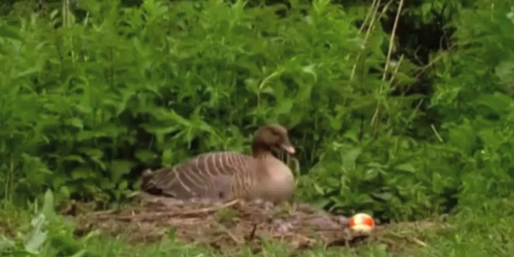
Organisms are biologically programmed to follow algorithms
Notes:
How good are they at this task? Are they

Slide 5
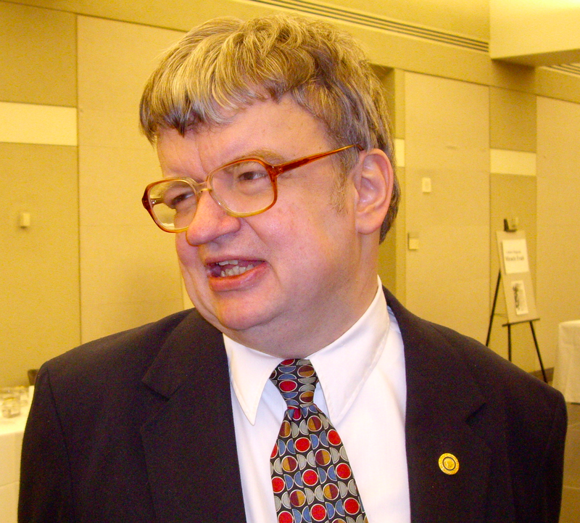
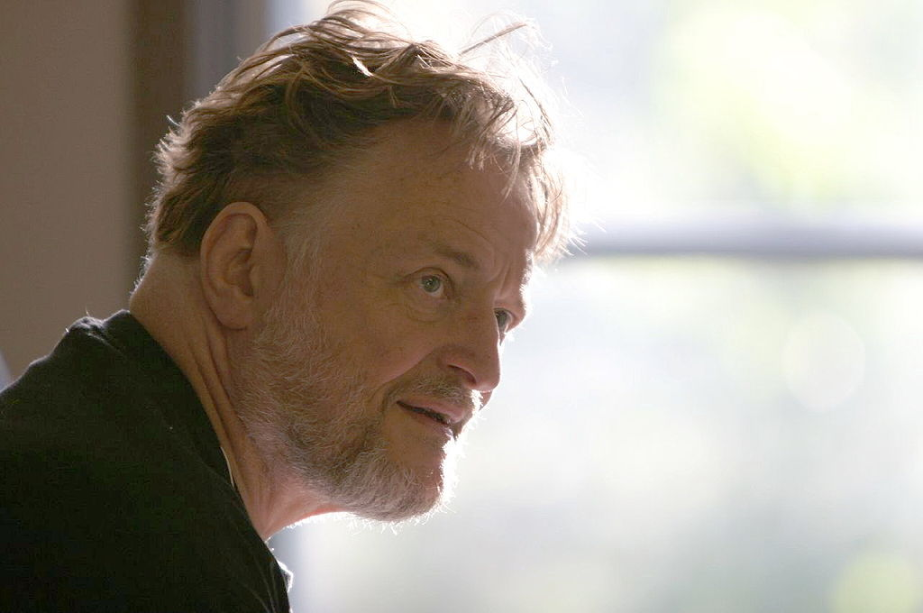
Algorithms describe how to determine output from input
Kim Peek
“Rain Man”
John Conway
inventor of the Doomsday algorithm
(and the Game of Life)
There is a standing assertion (the Church-Turing thesis) that any algorithm (on the natural numbers) that can be computed by mechanical means can be computed by a Turing machine.

Slide 6
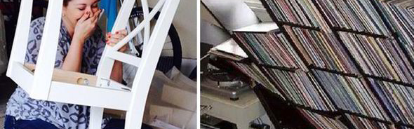
How good are living things at following algorithms?
In particular, are they inherently limited relative to computers?
(Is there any problem they can’t solve with an algorithm, which a computer could?)

Slide 7
Turing machines have:
Infinite memory, in the form of their “tape”
An instruction table describing the appropriate action for any given input
Can be represented by a set of Boolean functions, f_{i}: B^{n} → B
S
M
Q
P
c

Slide 8
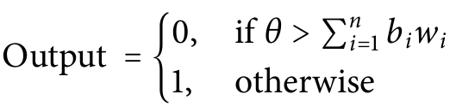
Neural systems are as computationally powerful as Turing machines
We can make a neuron that acts like a NAND gate
Any Boolean function can be constructed from NAND gates
We can make any “instruction table”
We can create memory by changing synapse strength through use and disuse
…or, by creating flip-flops (to do on problem set 1!)
w₁= -5
θ=-6
w₂= -5
Notes:
We say that they are “Turing complete”

Slide 9
…but not all organisms have neurons.
To show that all living things are Turing complete, we focused on a universal trait: gene expression.
More particularly, we focused on control of transcription initiation.
Replication
DNA
Transcription
RNA
Translation
Protein
Notes:
Ask, here, why cells bother to regulate gene expression.

Slide 10
Transcription initiation requires recruiting RNA polymerase to the appropriate start site
The “promoter”
Codes for the protein
Transl. Start
Transl. Stop
What we want to transcribe
RNA polymerase
Notes:
RNA polymerase is the protein (technically, protein complex) that uses DNA as a template to make RNA. At any given time there is a significant pool of it which is not bound to DNA yet. To begin transcription of a gene, we need to recruit RNA polymerase to an appropriate transcriptional start site.

Slide 11
Why is it important to position RNA polymerase properly?
First, why does it matter which side of the gene we start from?

Slide 12
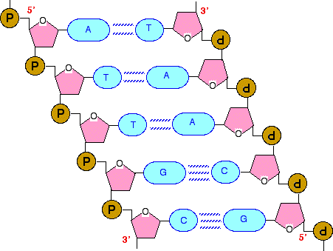
DNA is a directional polymer
5’
5’
3’
1’
4’
3’
2’
5’
3’
The two strands are antiparallel to one another

Slide 13
RNA polymerase can only elongate RNA at its 3’ end
Suppose this is the DNA fragment to be transcribed:
5’
3’
C
A
T
G
C
C
A
T
A
A
T
T
G
C
G
T
A
C
G
G
T
A
T
T
A
A
C
G
3’
5’
Notes:
Here is a DNA template

Slide 14
If RNA polymerase starts at the left and travels right:
5’
3’
C
A
T
G
C
C
A
T
A
A
T
T
G
C
5’
3’
C
G
T
A
C
G
G
T
A
T
T
A
A
C
G
3’
5’
Notes:
Here is a DNA template

Slide 15
If RNA polymerase starts at the left and travels right:
5’
3’
C
A
T
G
C
C
A
T
A
A
T
T
G
C
5’
3’
C
A
U
G
C
C
A
U
A
A
U
U
G
C
G
T
A
C
G
G
T
A
T
T
A
A
C
G
3’
5’
Notes:
Here is a DNA template

Slide 16
If RNA polymerase starts at the right and travels left:
5’
3’
C
A
T
G
C
C
A
T
A
A
T
T
G
C
G
3’
5’
G
T
A
C
G
G
T
A
T
T
A
A
C
G
3’
5’
Notes:
Here is a DNA template

Slide 17
If RNA polymerase starts at the right and travels left:
5’
3’
C
A
T
G
C
C
A
T
A
A
T
T
G
C
G
U
A
C
G
G
U
A
U
U
A
A
C
G
3’
5’
G
T
A
C
G
G
T
A
T
T
A
A
C
G
3’
5’
Notes:
Here is a DNA template

Slide 18
These two mRNAs are not equivalent
Translation
start site
Translation
stop site
5’
3’
C
A
U
G
C
C
A
U
A
A
U
U
G
C
5’
3’
G
C
A
A
U
U
A
U
G
G
C
A
U
G
Direction of translation
(also 5’ → 3’)

Slide 19
Why is it important to position RNA polymerase properly?
In addition to orientation, the exact position of initiation matters.
Beginning too early could add an unintended translation start site to the mRNA.
Beginning too late could exclude the intended translation start site from the mRNA.

Slide 20
Transcription initiation requires recruiting RNA polymerase to the appropriate start site
The “promoter”
Codes for the protein
Transl. Start
Transl. Stop
What we want to transcribe
RNA polymerase
Notes:
RNA polymerase is the protein (technically, protein complex) that uses DNA as a template to make RNA. At any given time there is a significant pool of it which is not bound to DNA yet. To begin transcription of a gene, we need to recruit RNA polymerase to an appropriate transcriptional start site.

Slide 21
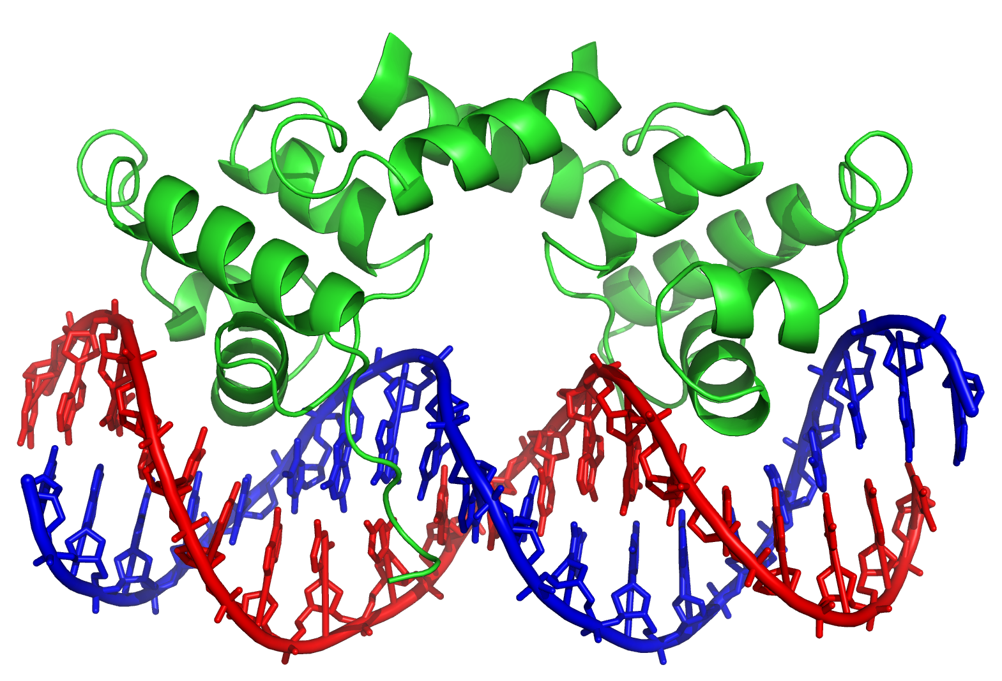
Transcription factors help position RNA polymerase
TACCTCTGGCGGTGATA
ATGGAGACCGCCACTAT
One end binds a specific DNA sequence
Notes:
Remind that these are proteins which recognize specific DNA sequences

Slide 22
Transcription factors help position RNA polymerase
The other can interact with
RNA polymerase
TACCTCTGGCGGTGATA
ATGGAGACCGCCACTAT
Notes:
Remind that these are proteins which recognize specific DNA sequences

Slide 23
Transcription factors help position RNA polymerase
Transcription factors that bind RNA polymerase can help recruit it
RNA polymerase
Transl. Start
Transl. Stop
Transcription factor (activator)
Transcription factors can also prevent RNA polymerase from binding
☹
Transl. Start
Transl. Stop
Transcription factor (repressor)

Slide 24
RNA polymerase recruitment can be imagined as a logic function
Binding site for activator
Binding site for repressor
Activator Repressor RNA Pol
OFF OFF OFF
ON OFF ON
OFF ON OFF
ON ON OFF

Slide 25
RNA polymerase recruitment can be imagined as a logic function
Activator Repressor RNA Pol
OFF OFF OFF
ON OFF ON
OFF ON OFF
ON ON OFF

Slide 26
RNA polymerase recruitment can be imagined as a logic function
RNA polymerase
Activator Repressor RNA Pol
OFF OFF OFF
ON OFF ON
OFF ON OFF
ON ON OFF

Slide 27
RNA polymerase recruitment can be imagined as a logic function
Activator Repressor RNA Pol
OFF OFF OFF
ON OFF ON
OFF ON OFF
ON ON OFF
Notes:
Ask, what about when both are there? Aiming for the notion that physically blocking the site where RNA polymerase needs to be will supersede any recruitment by the activator.

Slide 28
RNA polymerase recruitment can be imagined as a logic function
Activator Repressor RNA Pol
OFF OFF OFF
ON OFF ON
OFF ON OFF
ON ON OFF

Slide 29
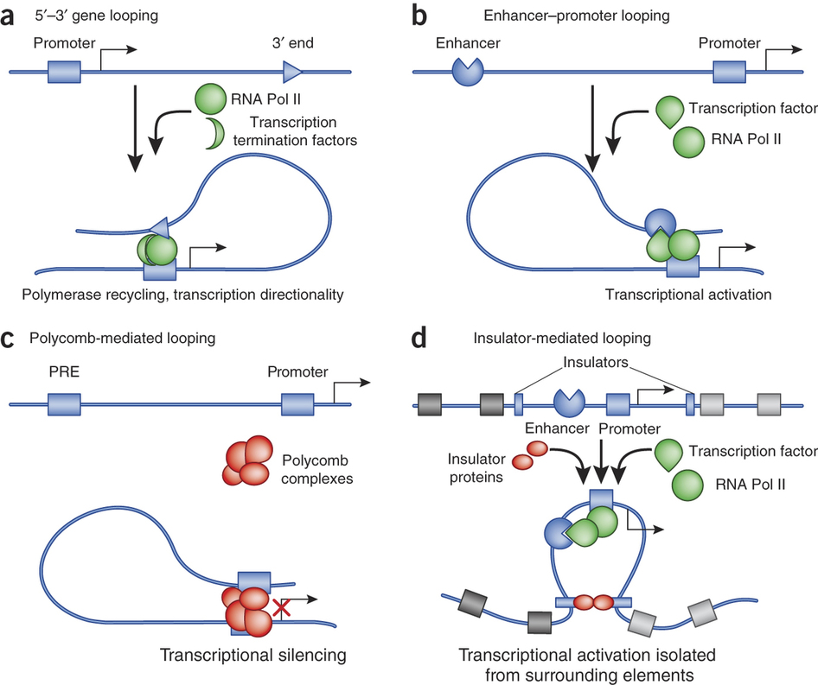
Transcription factors can also work from a distance
Many transcription factors can regulate RNA polymerase recruitment for a single gene

Slide 30
Can a single type of transcription factor regulate multiple genes? Why or why not?
Notes:
Audience answers

Slide 31
Transcription factors can regulate transcription of other transcription factors
TF1
TF2
Arrow indicates activation
Bar indicates repression
TF3
TF4
Notes:
Of course they can also regulate expression of “normal” proteins that perform functions besides gene regulation.

Slide 32
Inter-regulation of transcription factors generates gene regulatory networks
E. coli has ~4000 genes, of which 300 are transcription factors.
Roughly 20% of those transcription factors are shown here.
Alon Figure 2.3
Notes:
Of course they can also regulate expression of “normal” proteins that perform functions besides gene regulation.

Slide 33
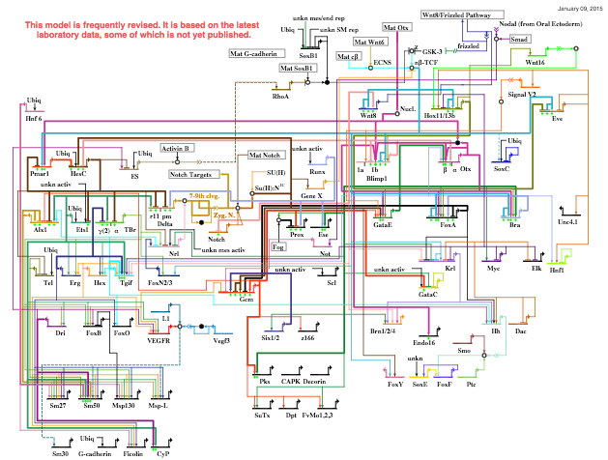
Another common representation of gene regulatory networks
Notes:
Step over to the board and actually describe what this diagram is

Slide 34
Can we make NAND gates?
How should we define inputs and outputs for gene regulation?
Should be the same type of quantity, so that the output for one gene can be the input for another.
Transcription factor concentration is a natural choice
[TF] = 0 → binding site not occupied
[TF] >> 0 → binding site occupied
Tempting to set a threshold in between to make quasi-continuous concentrations into Boolean variables.

Slide 35
Choosing the threshold for converting [TF] to a Boolean variable
The threshold concentration we choose should have physical meaning.
Ideally, if [TF] is above the threshold, it would be large enough to ensure that its binding sites are always occupied, and vice versa.
Probability bound
[TF]
Ideal threshold

Slide 36
When will our binding curve be a reasonable approximation of a step function?
We will see during the next week that binding curves are often hyperbolic.
This week you’ll learn why, and in the section on creating switch-like behaviors, you’ll see how the problem can be overcome.
Probability bound
[TF]
What we want
What we (might) get

Slide 37
Why would it be hard to make logic gates if binding probability is not switch-like?
Suppose the repressor is at an intermediate concentration.
Sometimes it will be bound and block RNA polymerase; sometimes not.
Activator Repressor RNA Pol
OFF OFF OFF
ON OFF ON
OFF ON OFF
ON ON OFF

Slide 38
Why would it be hard to make logic gates if binding probability is not switch-like?
Suppose the repressor is at an intermediate concentration.
Sometimes it will be bound and block RNA polymerase; sometimes not.
Activator Repressor RNA Pol
OFF OFF OFF
ON OFF ON
OFF ON OFF
ON ON OFF
Notes:
The output will also not be a Boolean value.

Slide 39
Why would it be hard to make logic gates if binding probability is not switch-like?
Suppose the repressor is at an intermediate concentration.
Sometimes it will be bound and block RNA polymerase; sometimes not.
The regulated gene will therefore be transcribed at some intermediate rate, so the output (RNA polymerase binding, and ultimately the concentration of the gene’s product) will not be a Boolean value.
This problem would arise at least every time the input transcription factor’s concentration transitioned from low to high, or vice versa.
Notes:
The output will also not be a Boolean value.

Slide 40
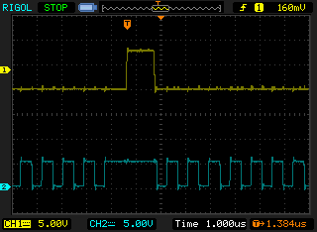
Your computer encodes Boolean values (“bits”) as high and low voltages (often 5V and 0V).
Voltage is a continuous quantity.
To get from high to low, or vice versa, must go through every value in between.
Why don’t the transitions cause problems for the computer?

Slide 41
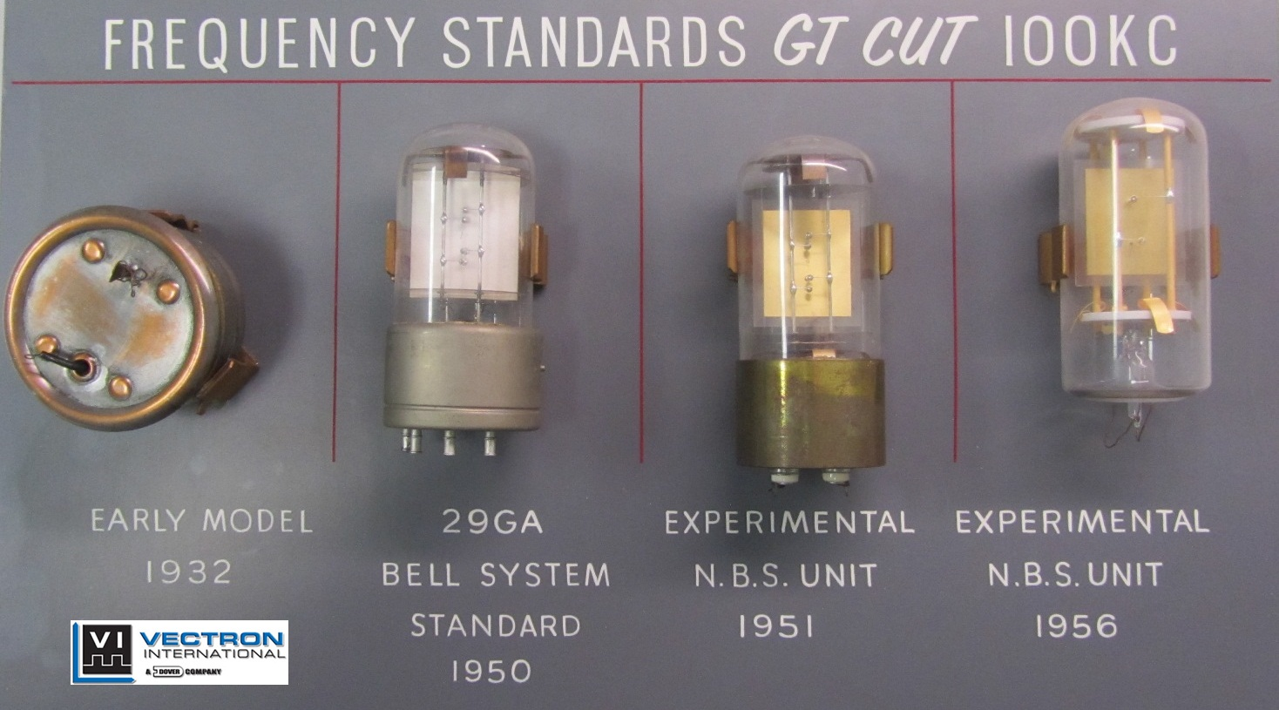
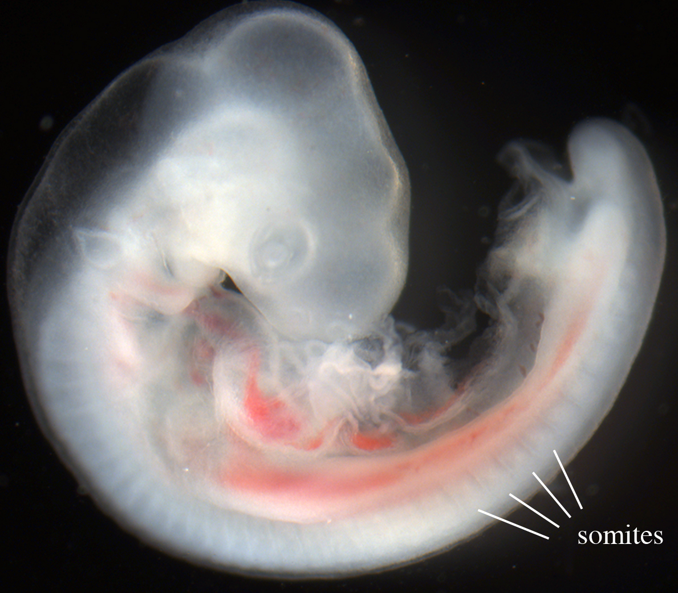
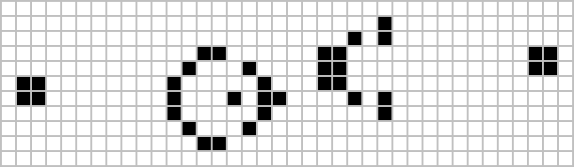
Synchronization through the clock prevents read-out during transitions
A biological clock helps a continuous wavefront pattern the somites (which give rise to vertebrae, ribs, etc.)
Notes:
Crystal oscillator emits sine wave

Slide 42
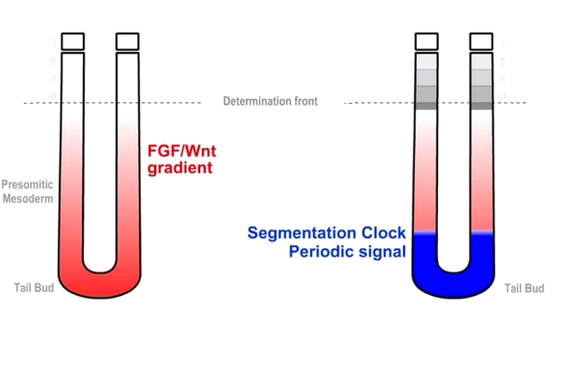
The clock-and-wavefront model of somitogenesis

Slide 43
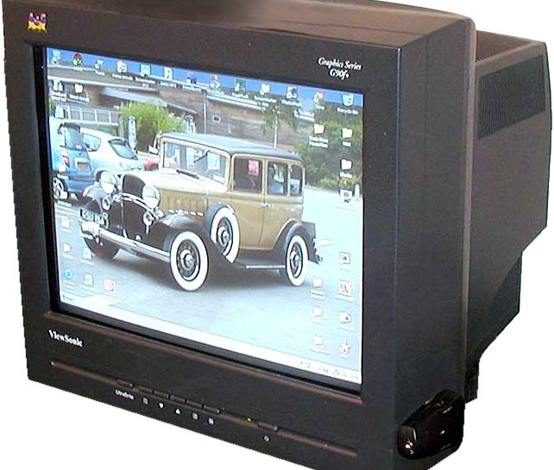
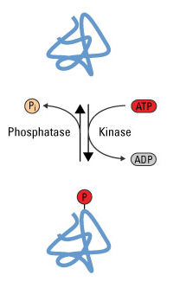
Separation of timescales
What if the input [TF]s changed much faster than gene expression occurred?
This can be achieved if the transcription factors are always present but are modified to become activated. (Post-translational modification is faster than gene expression.)
Unfortunately, this only works for shallow networks. We need to be able to string many NAND gates together.
A CRT monitor

Slide 44
Separation of timescales and synchronicity won’t always apply. In general we will not think of changes in input/output as instantaneous. Instead we will study the dynamics of continuous variables.

Slide 45
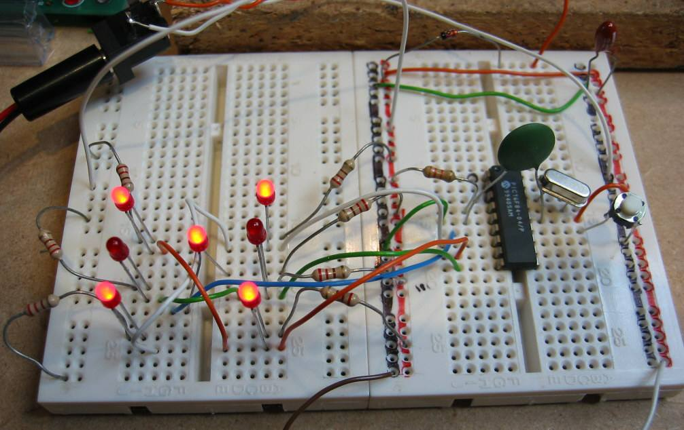
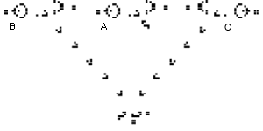
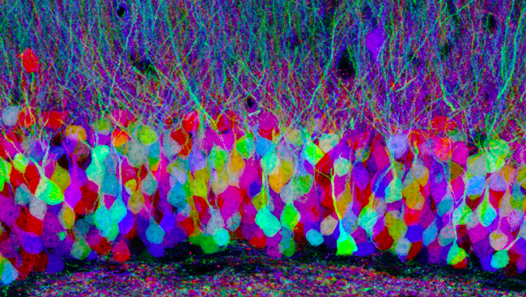
The issue of duplicate parts
Duplicate a TF gene &
use each copy for a different task in the same cell
Notes:
100 billion neurons in brain

Slide 46
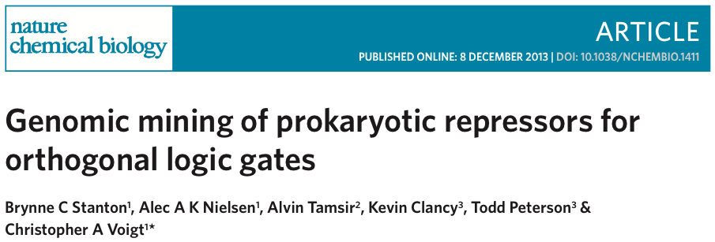
The first discussion paper

Slide 47
A checklist for computing via gene regulation
Treat gene regulatory networks as dynamical systems (week 2 onward)
Make switch-like binding curves (weeks 3-4)
Implement memory using feedback (weeks 4-6)
Create clocks for synchronization (week 7)
Make systems robust to noise caused by probabilistic binding (week 8)
Start building things! (week 12)

Slide 48
A checklist for computing via gene regulation
Treat gene regulatory networks as dynamical systems (week 2 onward)
Make switch-like binding curves (weeks 3-4)
Implement memory using feedback (weeks 4-6)
Create clocks for synchronization (week 7)
Make systems robust to noise caused by probabilistic binding (week 8)
Start building things! (week 12)

Slide 49
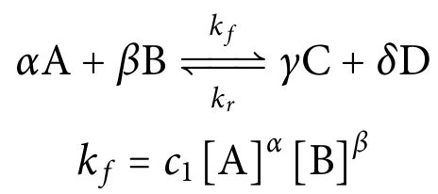
Law of Mass Action
If:
the medium is well-stirred, and
there are many molecules of each species present
Then:
The rate of a chemical reaction is proportional to the product of the concentrations of the reactants.
Kinetic
order of B
Notes:
Indicate which are the reactants and which are the products
This relationship is intuitive since all of the reactants must contact each other

Slide 50
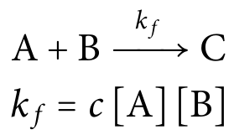
Law of Mass Action
Captures our intuition that molecules must collide with one another to react.
A
B
Notes:
Indicate which are the reactants and which are the products
This relationship is intuitive since all of the reactants must contact each other

Slide 51
Law of Mass Action
Captures our intuition that molecules must collide with one another to react.
A
B
Notes:
Indicate which are the reactants and which are the products
This relationship is intuitive since all of the reactants must contact each other

Slide 52
Law of Mass Action
Captures our intuition that molecules must collide with one another to react.
BAM!
Notes:
Indicate which are the reactants and which are the products
This relationship is intuitive since all of the reactants must contact each other

Slide 53
Law of Mass Action
Captures our intuition that molecules must collide with one another to react.
C
Notes:
Indicate which are the reactants and which are the products
This relationship is intuitive since all of the reactants must contact each other

Slide 54
Law of Mass Action
Captures our intuition that molecules must collide with one another to react.
A
A
A
B
Notes:
Indicate which are the reactants and which are the products
This relationship is intuitive since all of the reactants must contact each other

Slide 55
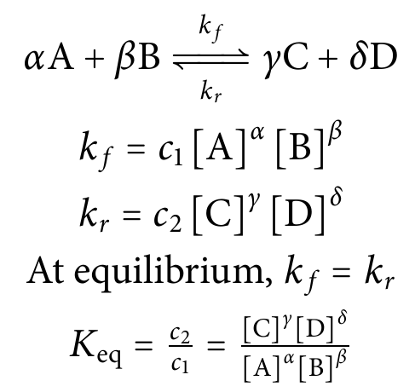
The reaction is at equilibrium when none of the molecular species’ concentrations are changing

Slide 56
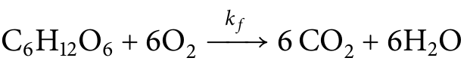
An example from biology: cellular respiration
(glucose)
Is k_{f} = c [C₆H₁₂O₆] [O₂]⁶ ?
This would require seven (7) molecules to simultaneously collide – highly unlikely!
Notes:
The implication here would be that seven molecules all need to collide with each other at the same time in order for the reaction to occur.

Slide 57
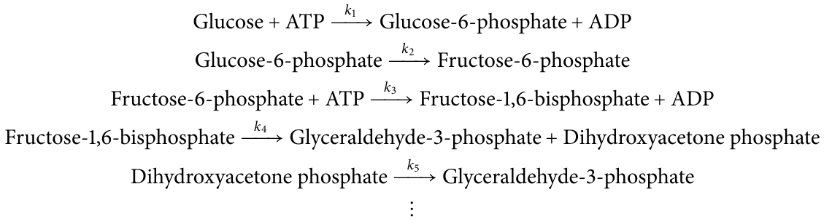
An example from biology: cellular respiration
(glucose)
This reaction
is especially slow
So is k_{f} ≈ k₃ = c [Fructose-6-phosphate] [ATP] ?

Slide 58
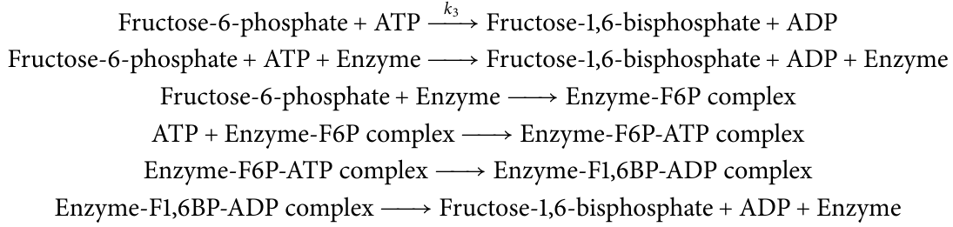
Many intercellular reactions are catalyzed by enzymes
Notes:
Definition of a catalyst

Slide 59
Energy landscape of the reaction
Transition state
‡
ΔG = - RT ln k_{f}
F6P + ATP
Gibbs Free Energy, G
ΔG = - RT ln K_{eq}
F1,6BP + ADP
“Reaction progress”
Notes:
Definition of a catalyst
R is gas constant 8.314 J/mol Kelvin
Free energy of the reaction vs. the free energy of the catalyst

Slide 60
Catalysts speed up the reaction by lowering the action energy, ΔG
‡
Transition state
‡
ΔG = - RT ln k_{f}
F6P + ATP
Gibbs Free Energy, G
ΔG = - RT ln K_{eq}
F1,6BP + ADP
“Reaction progress”
Notes:
Definition of a catalyst
R is gas constant 8.314 J/mol Kelvin
Free energy of the reaction vs. the free energy of the catalyst

Slide 61
Enzymes catalyze reactions by stabilizing the transition state
Visualization in PyMOL of phosphofructokinase
Notes:
Start with a scene showing the linear backbone of the protein. Indicate the amino acid sequence and remind students that proteins, like nucleic acids, have a directionality to the polymer. 300 amino acids is a typical length although this might just be a fragment of the full-length protein.
Point out ADP and F6P and clarify that we would actually expect to see ATP and F6P, or ADP and F1,6BP, bound in the in vivo case. ADP had to be used in place of ATP here because it is more stable and x-ray crystallography takes more time than ATP would last. Do they remember that oxygen is red and nitrogen is blue? Phosphorus is red here, and a positively-charged magnesium ion is shown in magenta. For scale, the carbon-carbon bonds are about 1 angstrom.
Switch to a cartoon view. We often show the shape of proteins in this way that highlights stabilizing helices and sheets. You have seen a representation of a protein like this in lecture already, when we showed a transcription factor bound to a DNA double helix.

Slide 62
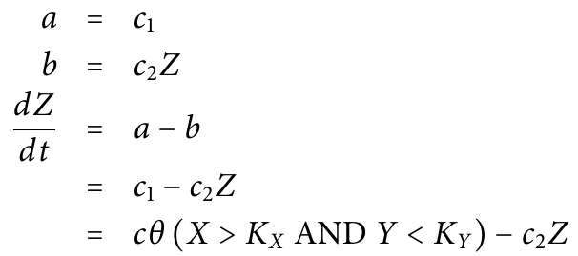
Simplifications with Boolean logic
Transcriptional regulation network
Chemical reaction network
a
b
Ø
Z
Ø
X
Y
Z
(and at the board)
Notes:
Start with a scene showing the linear backbone of the protein. Indicate the amino acid sequence and remind students that proteins, like nucleic acids, have a directionality to the polymer. 300 amino acids is a typical length although this might just be a fragment of the full-length protein.
Point out ADP and F6P and clarify that we would actually expect to see ATP and F6P, or ADP and F1,6BP, bound in the in vivo case. ADP had to be used in place of ATP here because it is more stable and x-ray crystallography takes more time than ATP would last. Do they remember that oxygen is red and nitrogen is blue? Phosphorus is red here, and a positively-charged magnesium ion is shown in magenta. For scale, the carbon-carbon bonds are about 1 angstrom.
Switch to a cartoon view. We often show the shape of proteins in this way that highlights stabilizing helices and sheets. You have seen a representation of a protein like this in lecture already, when we showed a transcription factor bound to a DNA double helix.

Slide 63
Next time:
Introduction to modeling
and common simplifying assumptions

